Slide 1
Data Translation challenge
Group 7:
Chun Chiu Lo
Gabriel Marken
Herman Singh
Kalahan Hughes
Salem Almheiri
March 15, 2022
Notes:
Anson

Slide 2
Important variables
covidunaw (Unable to work due to Covid): No = 1, Yes = 2
Employment status: Armed forces = 1 , At work = 10, has job not work last week = 12, Unemployed experienced worker = 21, unemployed new worker = 22, Not in labor force = 30-36
Sex: Male = 1, Female = 2
We turned the variable "age" into a binary variable (called young) to make it easier to work with in our models. We used the age 41 as a cutoff for young vs. old workers.
The assumption here is that if a worker is 41 or younger, then they are a millennial or Gen Z, which can be considered groups of young people.
We also turned the variables “empstat,” “indname,” and “sex” into binary variables as well to indicate whether a person was working or not, working in retail or not, and male or not.
Notes:
Anson

Slide 3
Testing for Heteroscedasticity and Hypothesis tests
Example Code:
bptest(modelname)
linearHypothesis(modelname, c("coefficient1 = 0", "coefficient2 = 0", "coefficient1:coefficient2 = 0"))
We use the Breusch-Pagan test above to check for Heteroscedasticity. The p-values here are far below 0.05, so we reject the null for the Breusch-Pagan test which is that the variance of the residuals is constant. Heteroscedasticity is present so we need robust standard errors.
Additionally we did hypothesis tests on the coefficient of interests for the different models. We tested the coefficients against the null hypothesis of them equalling zero. The results for the hypothesis testing are statistically significant so we can reject the null.
Notes:
Anson

Slide 4
Question 2
How has retail fared relative to other industries?
Notes:
Salem

Slide 5
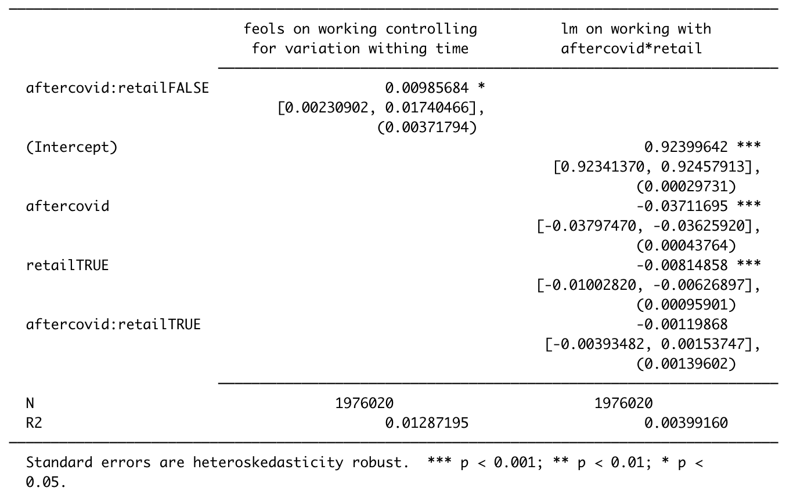
Model 1 and model 2
Model 1 <- fulldata %>% feols(working ~ aftercovid:retail | yearmonth)
Model 1 is a fixed effects model showing employment trends while controlling for variation within time
Model 2 <- lm(working ~ aftercovid*retail, data = fulldata)
Model 2 is a multivariate regression model showing the difference in employment trends before and after Covid in the retail industry.
Notes:
Salem

Slide 6
How has retail fared
Coefficients of Interest(lm model with aftercovid*retail):
Intercept: 0.92
Aftercovid: -0.037
aftercovid:retailTRUE: -0.0012
Implications: Partial derivative of model 2 wrt aftercovid => B1 + B3retailTRUE = -0.037 + (-0.0012)
Notes:
Salem

Slide 7
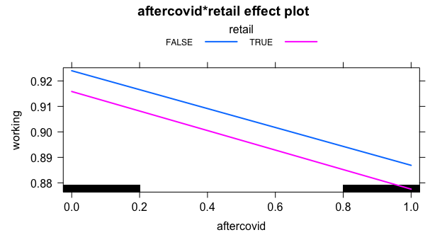
Model 2 plot
Notes:
(Salem)
The general trend of aftercovid shows that employment status of people generally went down, however the retail industry was hit harder. One plausible explanation is service sectors in general dealt worse with the pandemic as compared to industries that deal with goods.

Slide 8
Question 3
Retail needs to worry about who has money to spend - what has changed about who is working and earning money?
Notes:
Gabe

Slide 9
Model 3, model 4, and model 5
Model 3 <- lm(working ~ aftercovid*retail + young, data = fulldata)
Model 3: a multivariate regression model showing the difference in employment trends before and after Covid in the retail industry controlling for age.
Model 4 <- lm(working ~ aftercovid*retail + male, data = fulldata)
Model 4: a multivariate regression model showing the difference in employment trends before and after Covid in the retail industry controlling for sex.
Model 5 <- lm(working ~ aftercovid*retail + young + male, data = fulldata)
Model 5: a multivariate regression model showing the difference in employment trends before and after Covid in the retail industry controlling for age and sex.
Notes:
Gabe

Slide 10
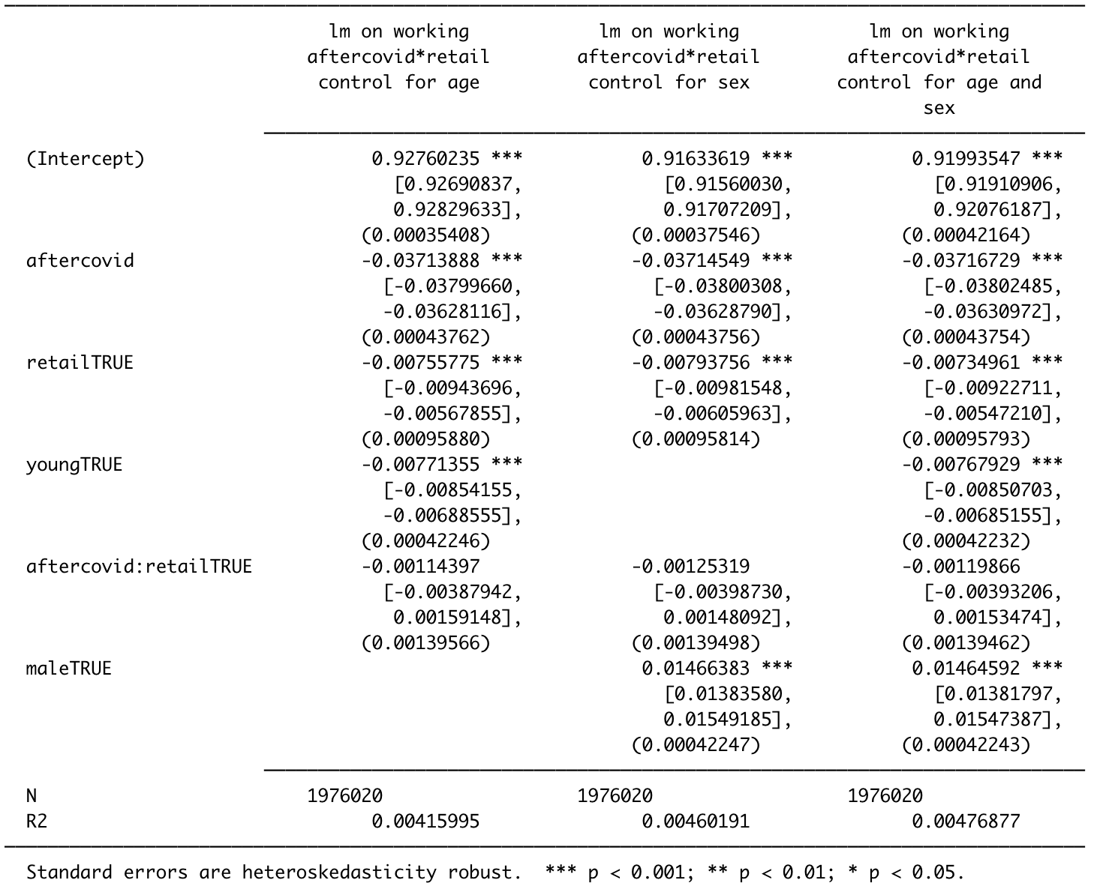
Notes:
(Gabe) Remember to interpret the coefficients on retailTRUE and youngTRUE showing the general trend of these people working less. This helps to reinforced the next models which show that people old and females have earnings that show the same type of effect that is show with their working status.

Slide 11
Model 6 and model 7
Model 6 <- lm(earnweek ~ aftercovid*young, data = fulldata)
Model 6: a multivariate regression model showing the difference in earning trends by age before and after Covid.
Model 7 <- lm(earnweek ~ aftercovid*male, data = fulldata)
Model 7: a multivariate regression model showing the difference in earning trends by sex before and after Covid.
Notes:
Kalahan

Slide 12
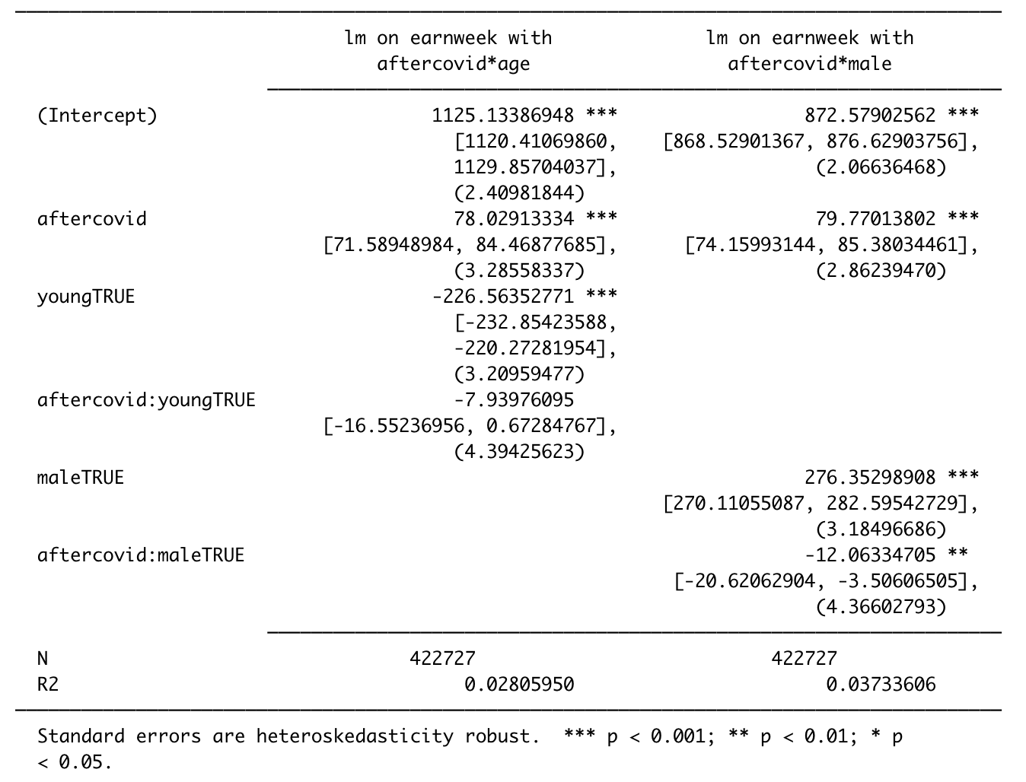
Notes:
Kalahan

Slide 13
who is working and earning money?
Coefficients of Interest(lm models aftercovid*age and aftercovid*male):
Intercept (young): 1125.13
Intercept (male): 872.58
YoungTRUE: -226.56
MaleTRUE: 276.35
aftercovid:MaleTRUE: -12.06
aftercovid:YoungTRUE: -7.94
Implications: Partial Derivative of model 6 wrt aftercovid => B1 + B3youngTRUE = 78.03 + (-7.94)
Partial Derivative of model 7 wrt aftercovid => B1 + B3MaleTRUE = 79.77 + (-12.06) The gap however is still large from pre-covid
Notes:
Kalahan

Slide 14
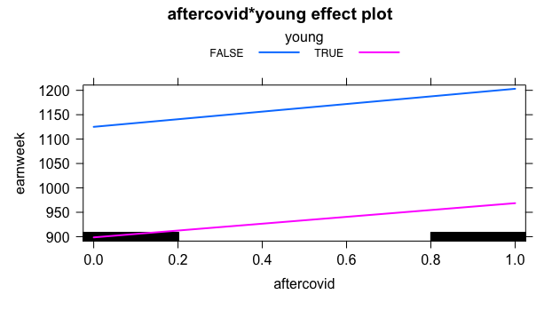
Model 6 plot
Notes:
(Herman) Earning increased as a general trend (those working are “essential” or have jobs whose earning power increased) however young people are earning less money than old people on average. One plausible explanation is old people tend to have more human capital?

Slide 15
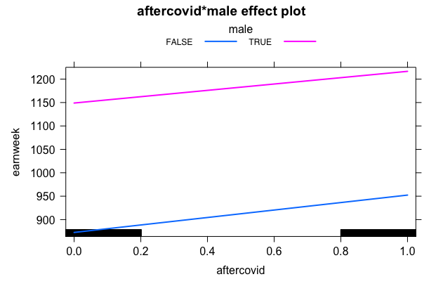
Model 7 plot
Notes:
(Herman) Earning increased as a general trend (those working are “essential” or have jobs whose earning power increased) however those that are male are earning more on average. One plausible explanation is that secondary earners ( primarily women although gap is decreasing) shifted towards home activities and/or started with less human capital.

Slide 16
Thank you For Listening
Notes:
Herman

